Slide 1

Varahi 🪙👩🌸
Empowering Women, One Step at a time

Slide 2

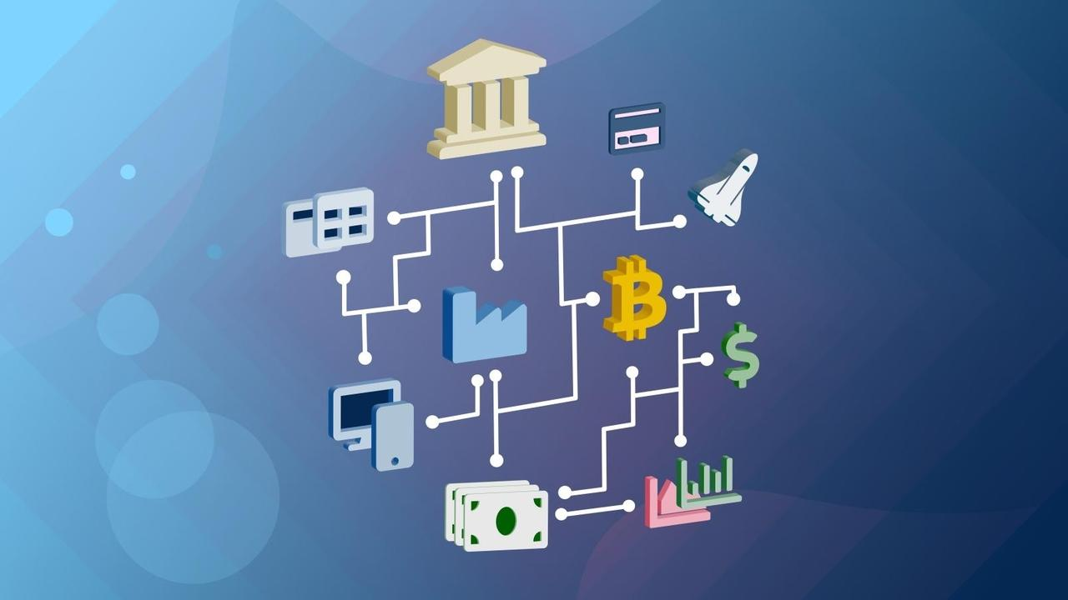

The Need
...
Problem Statement: Develop an app that enhances financial empowerment among women. The app should provide educational resources, tools for budgeting, expense tracker, financial planning, SIP calculator, EMI calculator, and investment portfolio tracker, tailored to women's financial goal.

Slide 3
Investment Portfolio tracking
Expenses & Savings
Personalized profile & security
Budget Planning
Financial literacy
modules
Fraud alerts
Financial schemes
benefits
Digital Banking
SIP & EMI
Calculator &
Alerts
Financial guidance
chatbot
Cost saving suggestions
Women Entrepreneur
support

Slide 4
01
Digital Banking
Banking
✅ QR Code Payments & Quick Pay
✅ Fraud alerts
✅ Loan & Credit alerts
✅ Maitrika-Financial AI Bot
QR Scanning & Payment
QR scanning enables quick and secure payments by scanning qr codes,hence reducing reliance on cash.
  Tech Implentation: (html5-qrcode),OpenCV & Pyzbar,SQLite(database)
Quick Pay Options
Save frequently used QR codes helping streamline daily transactions for instant payments, enabling women to manage their finances more efficiently.
Tech Implementation:Store frequently used QR codes in a SQLite database and retrieve them via Flask API

Slide 5
Women-Centric Bank Offers
Showcase banks and govt schemes providing unique benefits for women (low-interest loans, higher savings rates, etc.).
Tech Implementation: Integrate bank APIs to fetch and display real-time offers, updating dynamically via Flask backend and frontend rendering with JavaScript.
Fraud Alerts
Instant alerts for ongoing fraud schemes with tips on prevention
Tech Implementation: Firebase Cloud Messaging (FCM) for real-time push notifications

Slide 6
Maitrika – AI Financial Guidance Bot
AI-driven chatbot serves as a virtual financial mentor for women, providing personalized financial advice, budgeting tips, and investment guidance.
AI Driven Budget advice
Tech Implementation:
NLP models (Dialogflow/Rasa)
Fraud prevention tips
Expense Analysis
Financial Advice
Financial Insights(tax)

Slide 7
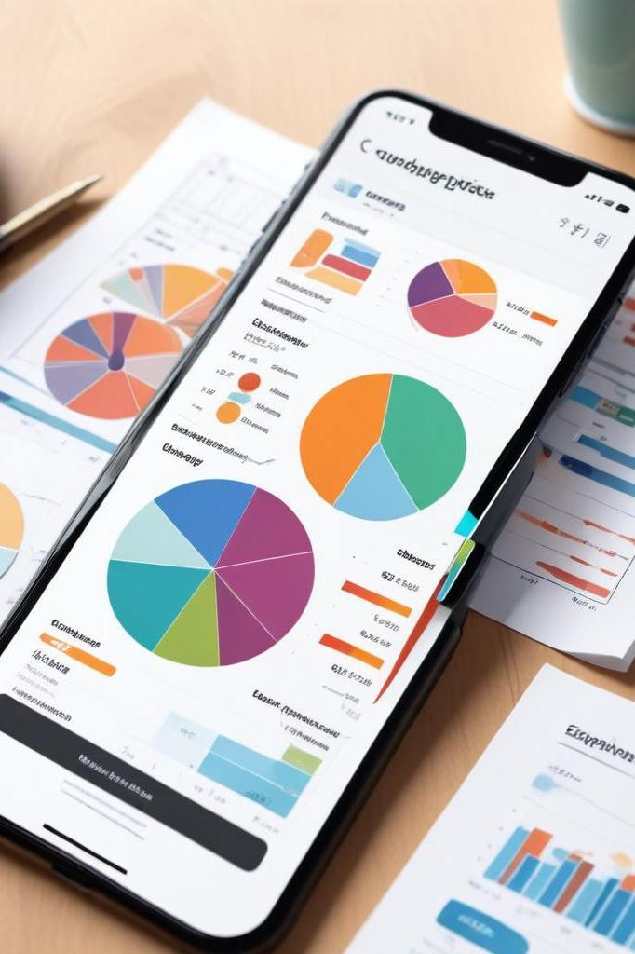
02
Budget
Predefined Categories
Involves categorizing expenses into predefined categories such as groceries, bills, and savings.
Tech Implementation:HTML
Spending Graphs
Visual representations of expenses using charts
help users gain insights into their finances.
Tech Implementation: Tools like Chart.js or D3.js

Slide 8
Over budget spend alerts
Get alerts when approaching your set spending limits.
Tech Implementation: FireSignal.JavaScript
Special Feature: Menstrual Hygiene is emphasized in budgets.
Cost-Saving Suggestions
Suggest cheaper alternatives instead of costly purchases or highlight discounts based on purchases.
Tech Implementation: Web Scraping

Slide 9
Personalized Budget Allocation
Allocate a fixed amount for personal use each month by the feature of pre-defined categories and store in the database.
Tech Implementation: SQLite
Elder/Spouse Connect
Secure, private space to discuss financial matters with close ones and ask for financial guidance. Allows users to share their expense and investments portfolio from the website.
Tech Implementation: Signal Protocol

Slide 10
Women’s Financial Schemes Alerts
Receive real-time notifications about government and bank schemes for women.
Tech Implementation: API Integrations
Waste Selling ReConnect.
List local recyclers where users can sell unwanted goods and hence promote sustainability and earn money too
Tech Implementation: Location Based APIs(LOCAL)

Slide 11
03
Investments
Calculators for SIP & Loans
User-friendly calculators for SIP, loan, and EMI management.
Women-Centric Investment Opportunities
Notify users about women-centric investment opportunities.
Investment Portfolio Tracker and Tax Benefits
Track, manage, and grow investments with tax-saving benefits, tailored for women.
Tech Implementation: Database with third party web API Integration

Slide 12
Freelancing & Work-From-Home Job Listings
List of currently available women-friendly freelancing and work-from-home job opportunities which are periodically updated.
Tech Implementation:API Integrations
Women Entrepreneurship Support NGOs
Connect women entrepreneurs with NGOs offering support, funding, and mentorship to woman entrepreneurs (home scaled industries)
Tech Implementation: Database like SQLite

Slide 13
Skill Development Centers Locator
Help women find nearby skill development centers for upskilling.
Tech Implementation: Location Based API(Google Maps)
Crowdfunding Opportunities
Display crowdfunding opportunities tailored for women-led businesses.
Allows women to try for crowdfunding and even market their products as part of their own business.

Slide 14
04
Financial Education
Educational Videos & Resources
Curated videos to educate users on basic savings, tax-saving investments, and more.
Tech Implementation:Embedded Youtube video platforms
Gamified Learning Experience
Interactive learning through challenges, quizzes, and educational games.Allows users to maintain streaks with their friends to motivate for better learning.
Tech Implementation:ReactJS

Slide 15
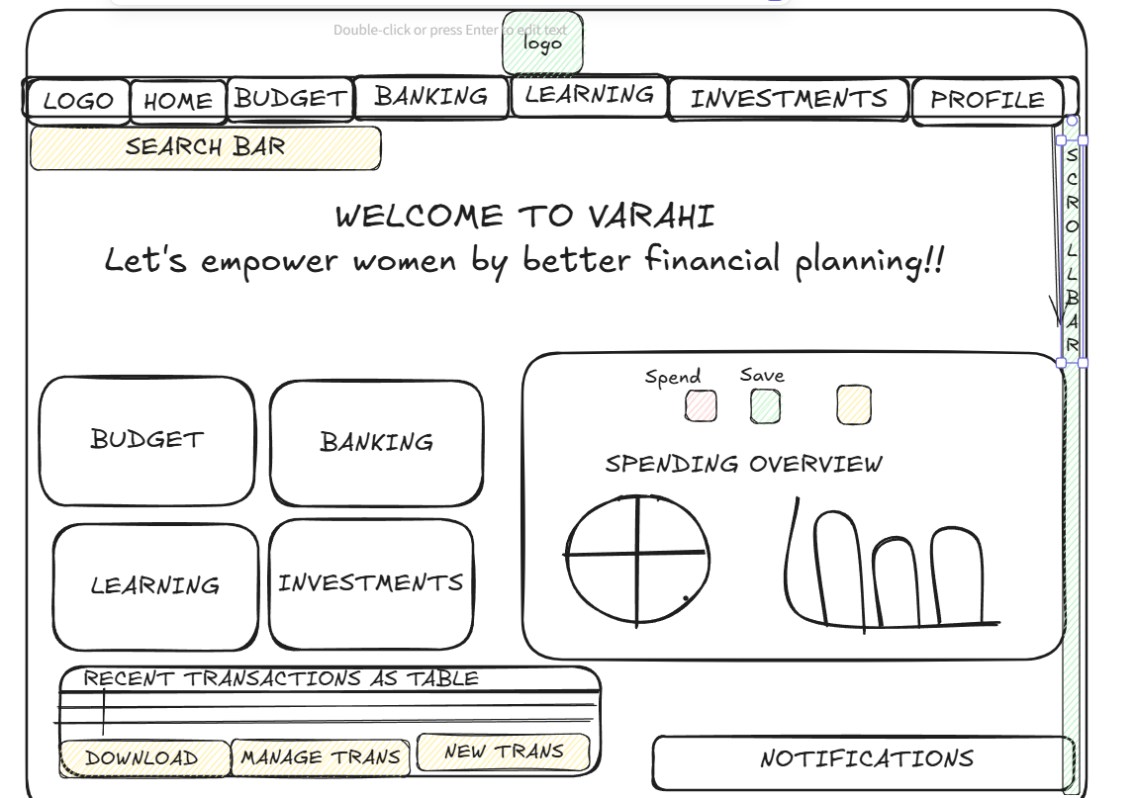
WIREFRAME FOR THE WEBSITE

Slide 16
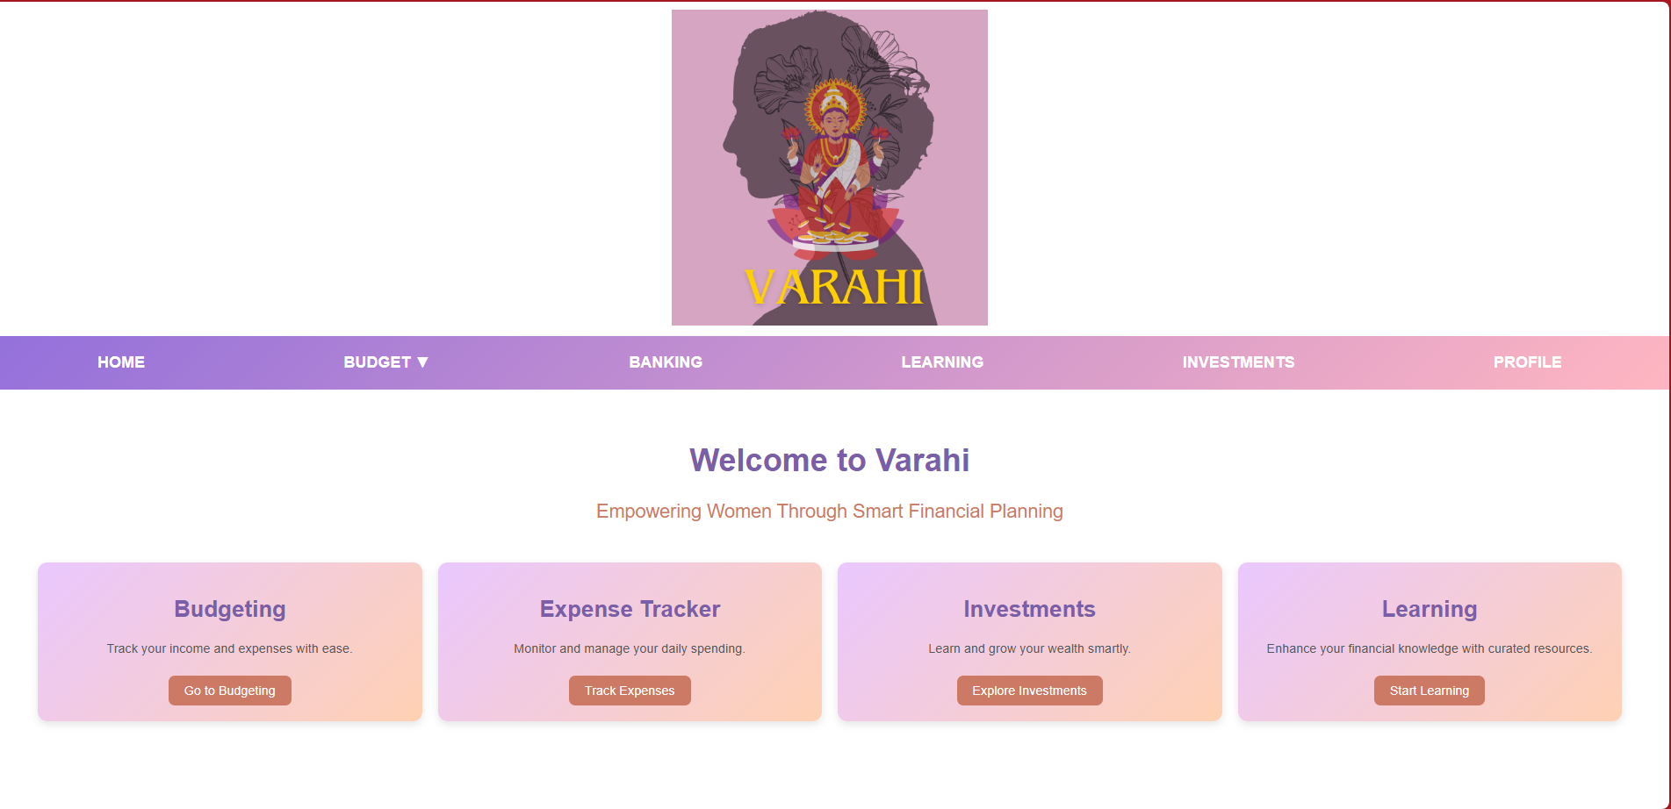

Slide 17
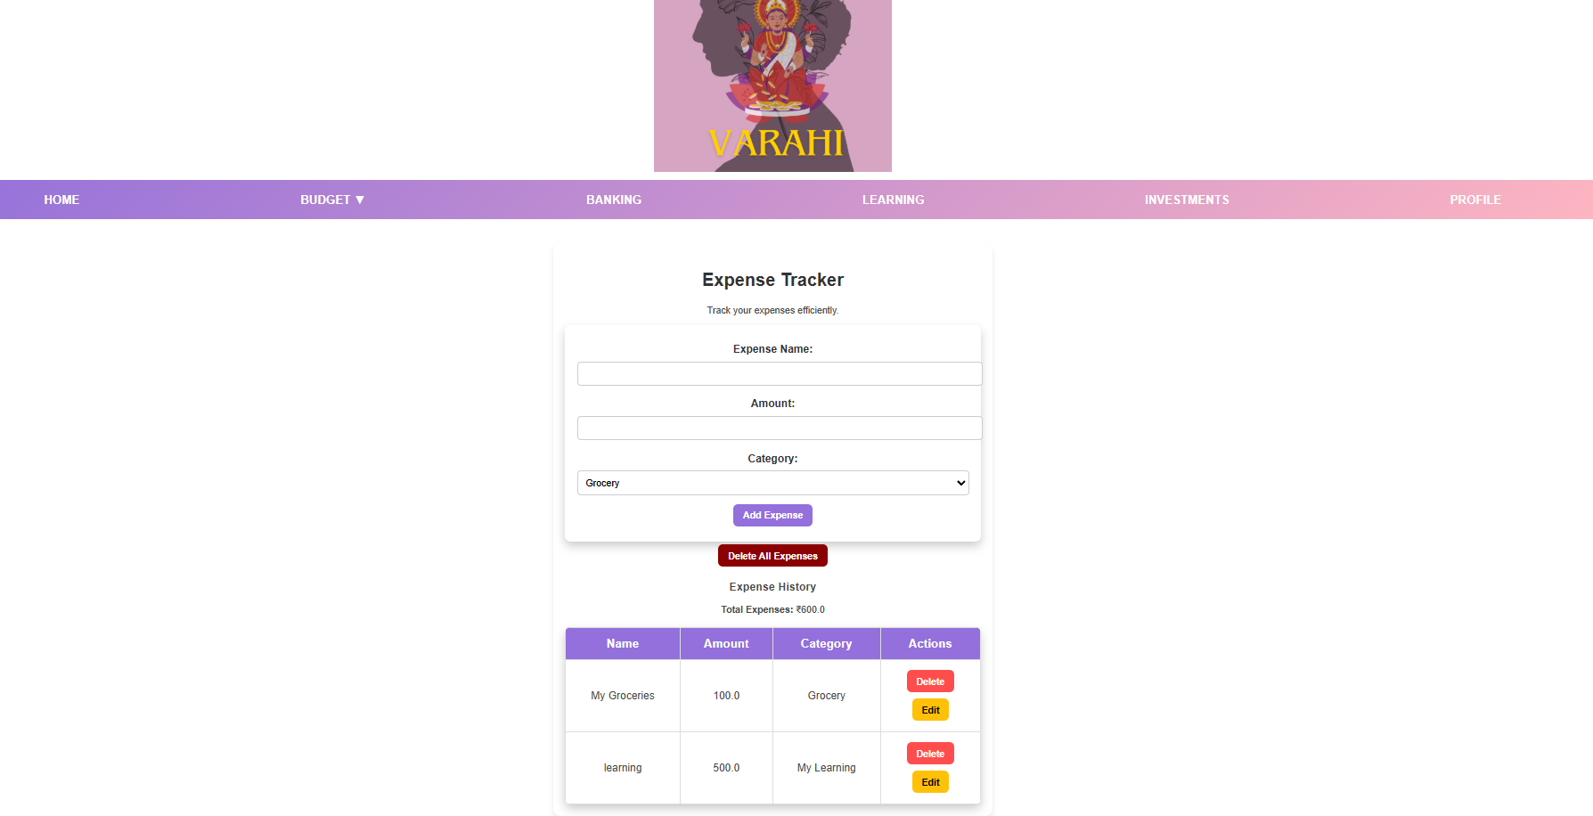

Slide 18
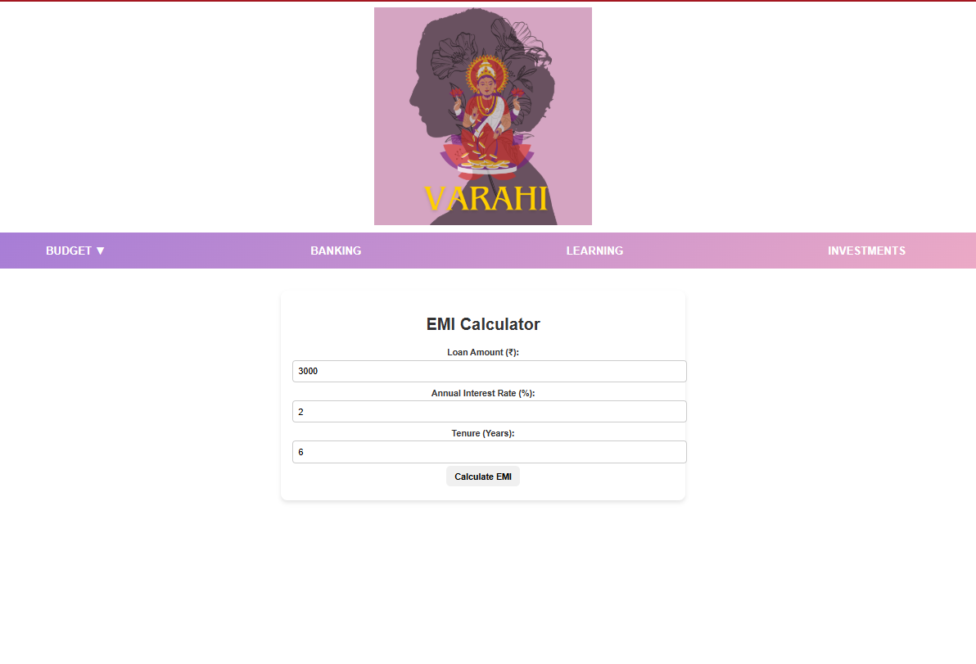
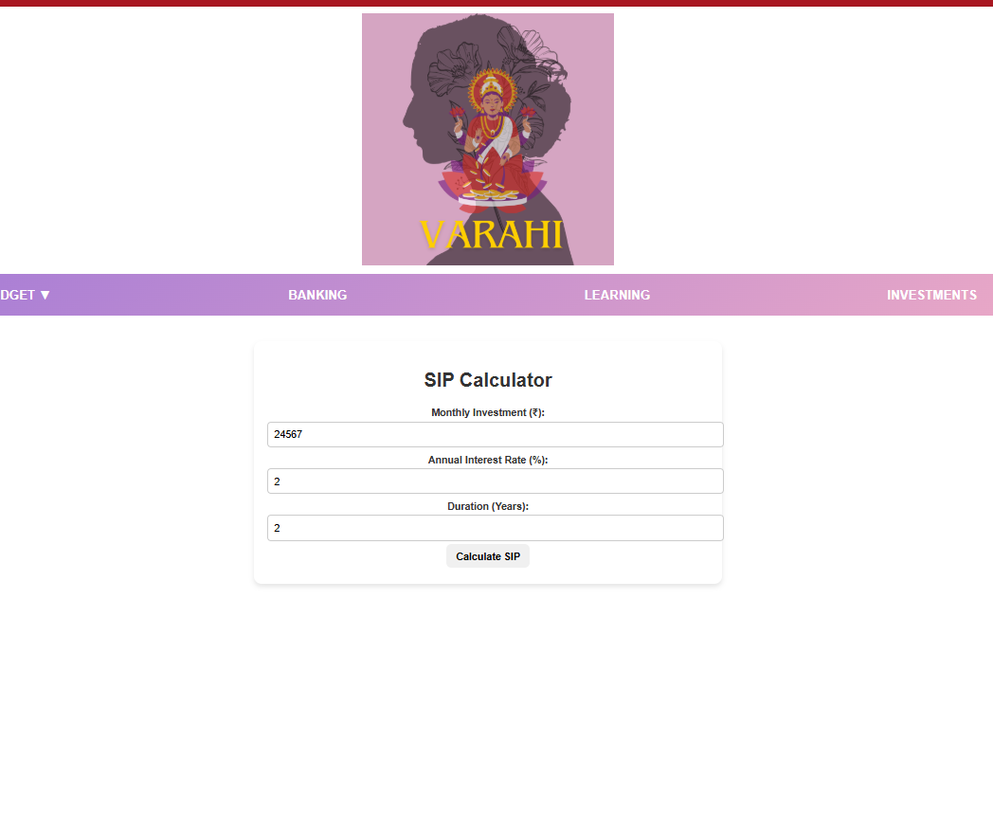
Don't forget
...
Don't forget
...

Slide 19
...

